Slide 1


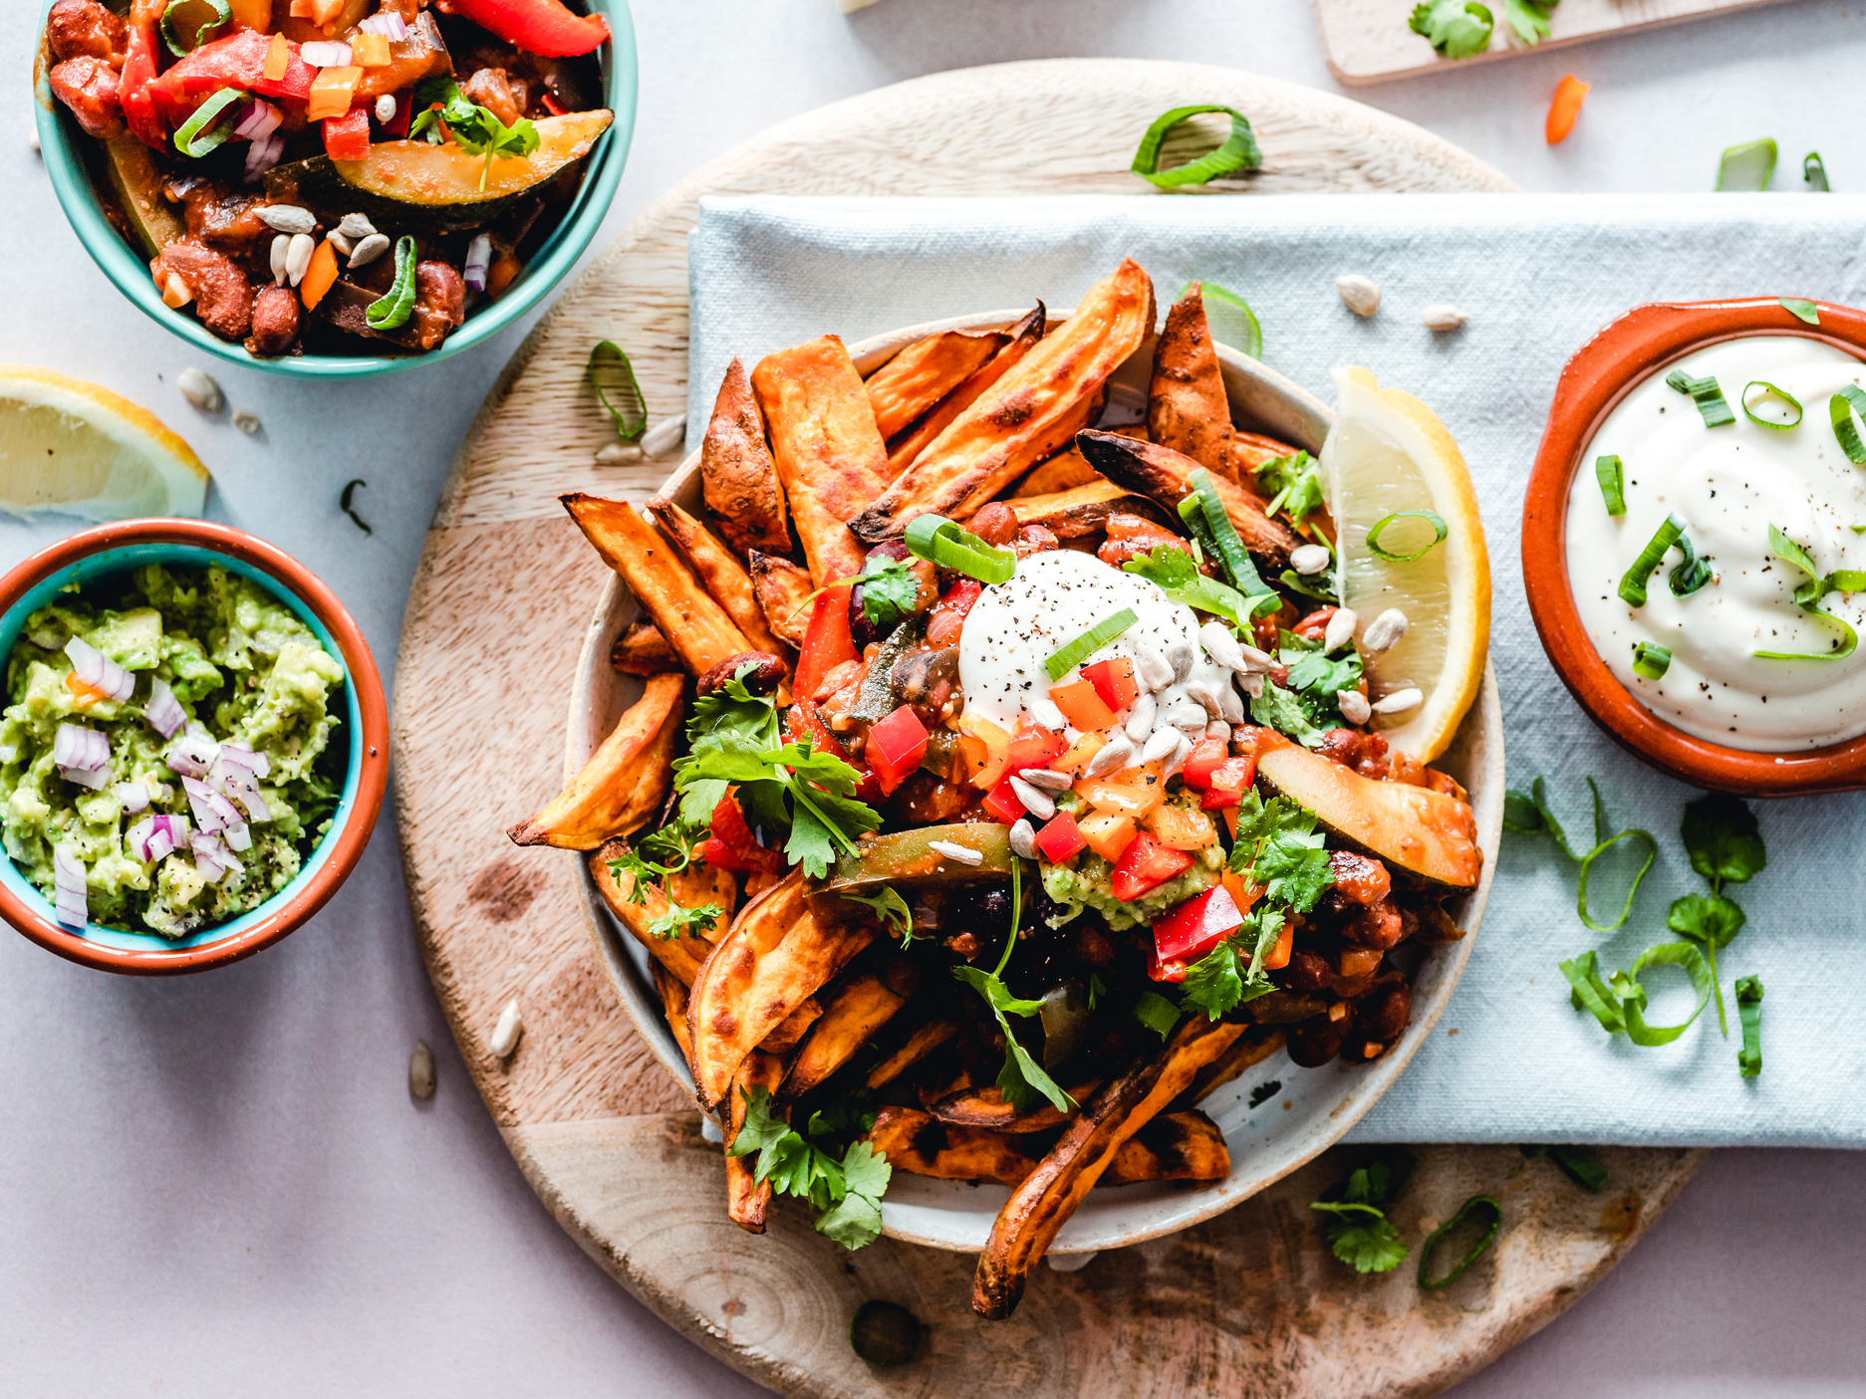

Swiggy
ADVANCE SQL
PROJECT
Presentation by :
Anoop Alabnoor
www.linkedin.com/in/anoop1420

Slide 2
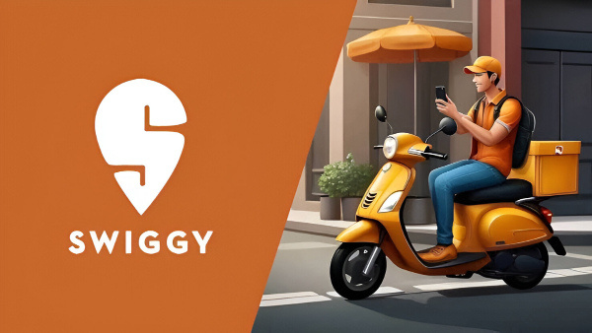
PROJECT INTRODUCTION
Swiggy, India’s leading food delivery platform, strives to enhance customer satisfaction and streamline operations through data-driven insights. This project analyzes Swiggy’s SQL dataset to uncover patterns in customer behavior, restaurant performance, anddelivery partner efficiency. The findings will guide Swiggy in optimizing its services, increasing sales and boosting customer satisfaction journey

Slide 3
Problems
Questions:
Display all customers who live in 'Delhi'.
Find the average rating of all restaurants in 'Mumbai'.
List all customers who have placed at least one order.
Display the total number of orders placed by each customer.
Find the total revenue generated by each restaurant.
Find the top 5 restaurants with the highest average rating.
Display all customers who have never placed an order.
Find the number of orders placed by each customer in 'Mumbai'.
Display all orders placed in the last 30 days.
List all delivery partners who have completed more than 1 delivery
Find the customers who have placed orders on exactly three different days.
Find the delivery partner who has worked with the most different customers.
Identify customers who have the same city and have placed orders at the same restaurants, but on different dates.

Slide 4
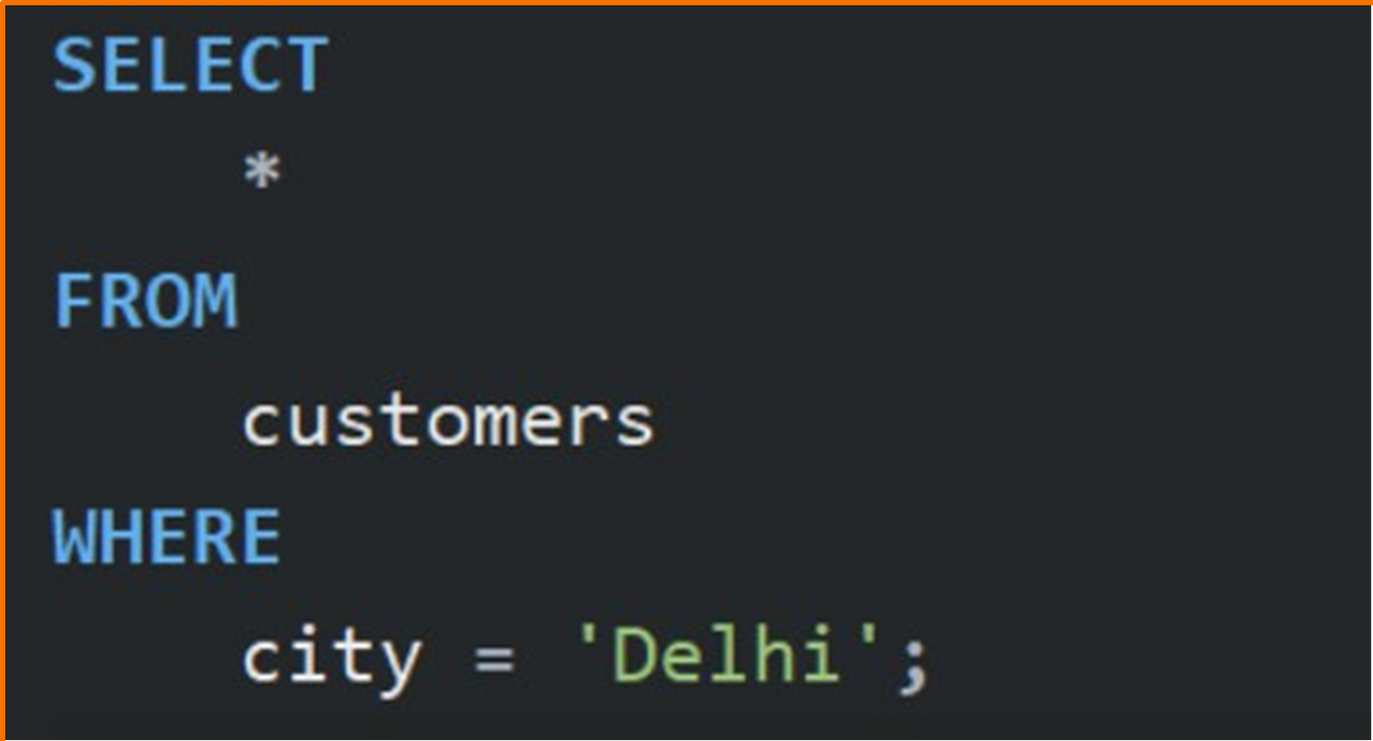
Display all customers who live in 'Delhi'.

Slide 5
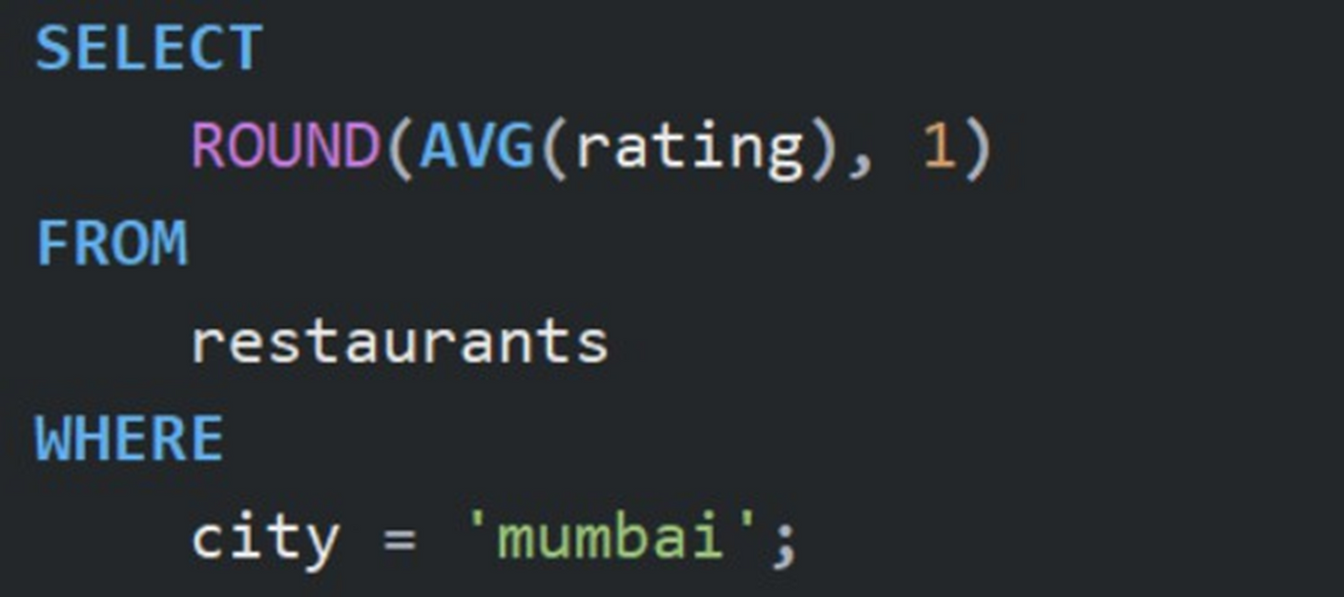
2. Find the average rating of all restaurants in 'Mumbai'.

Slide 6
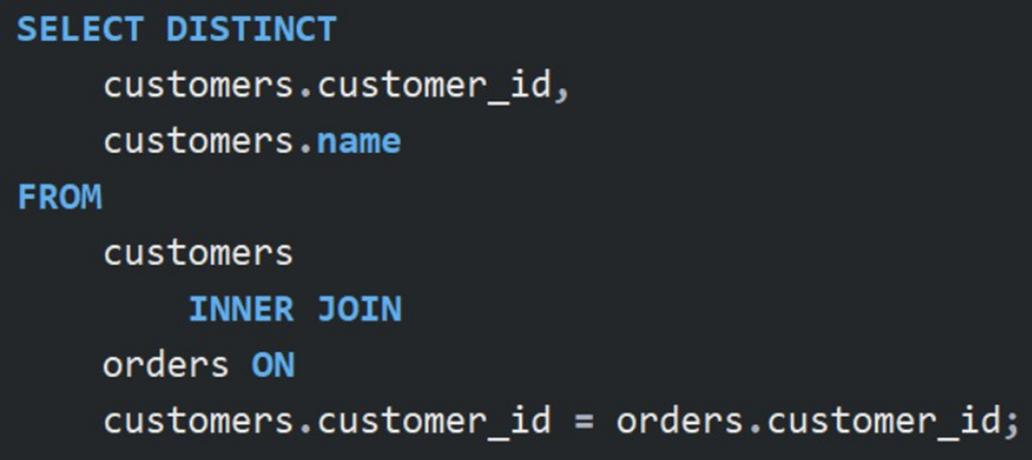
3. List all customers who have placed at least one order.

Slide 7
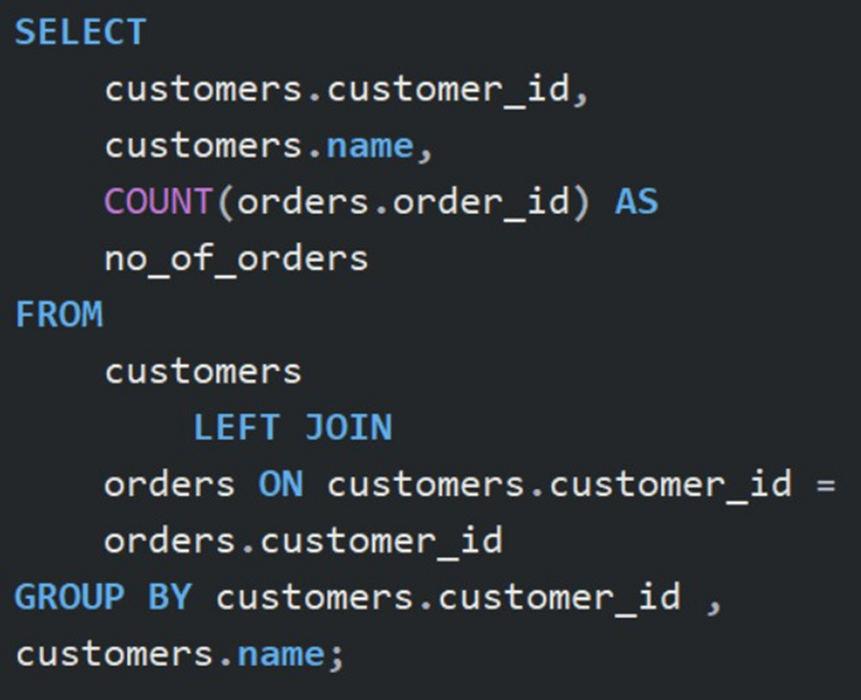
4. Display the total number of orders placed by each customer.

Slide 8
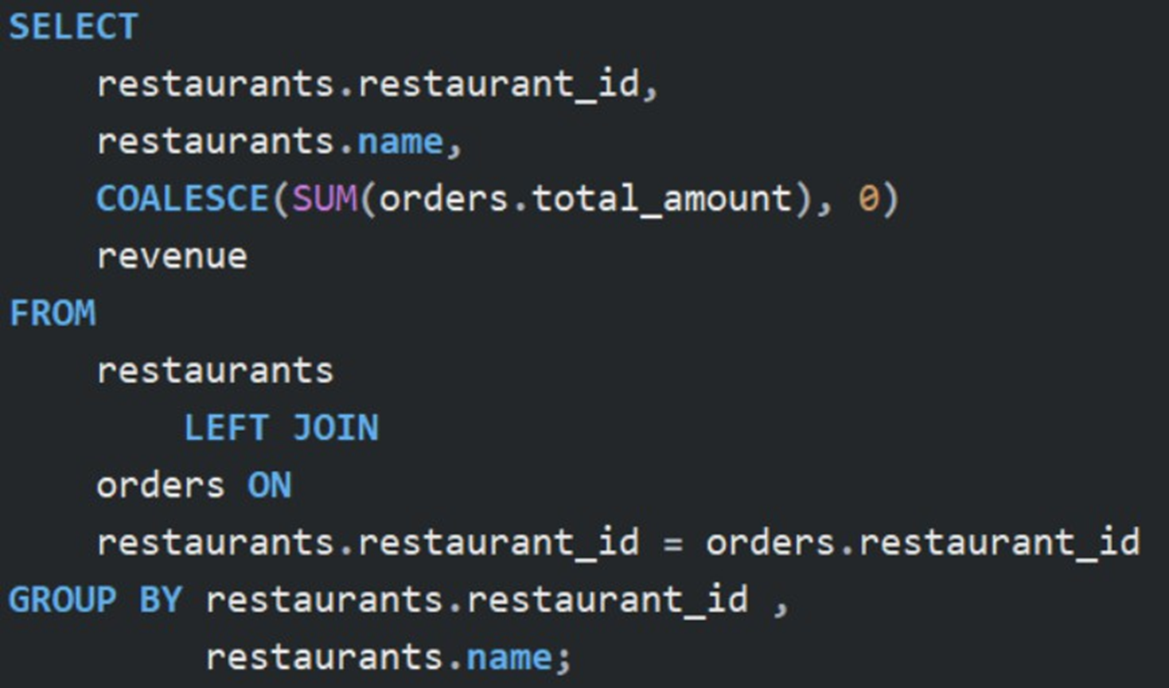
5. Find the total revenue generated by each restaurant.

Slide 9
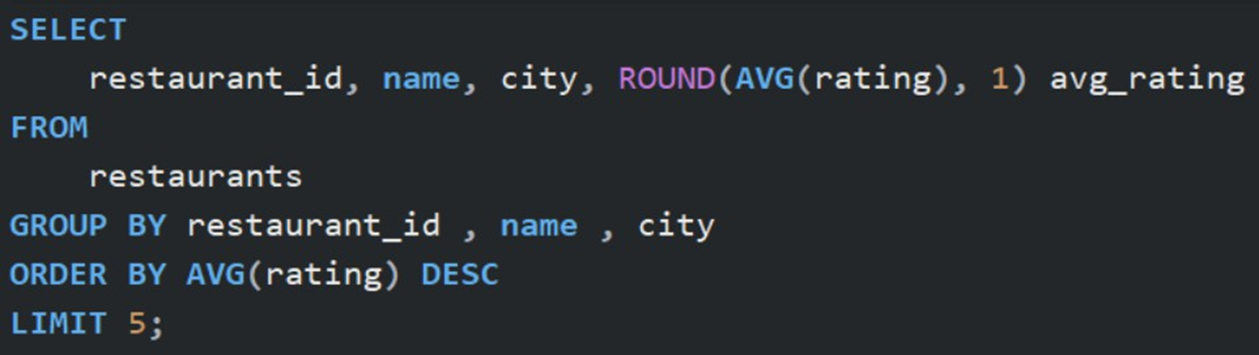
6. Find the top 5 restaurants with the highest average rating.

Slide 10
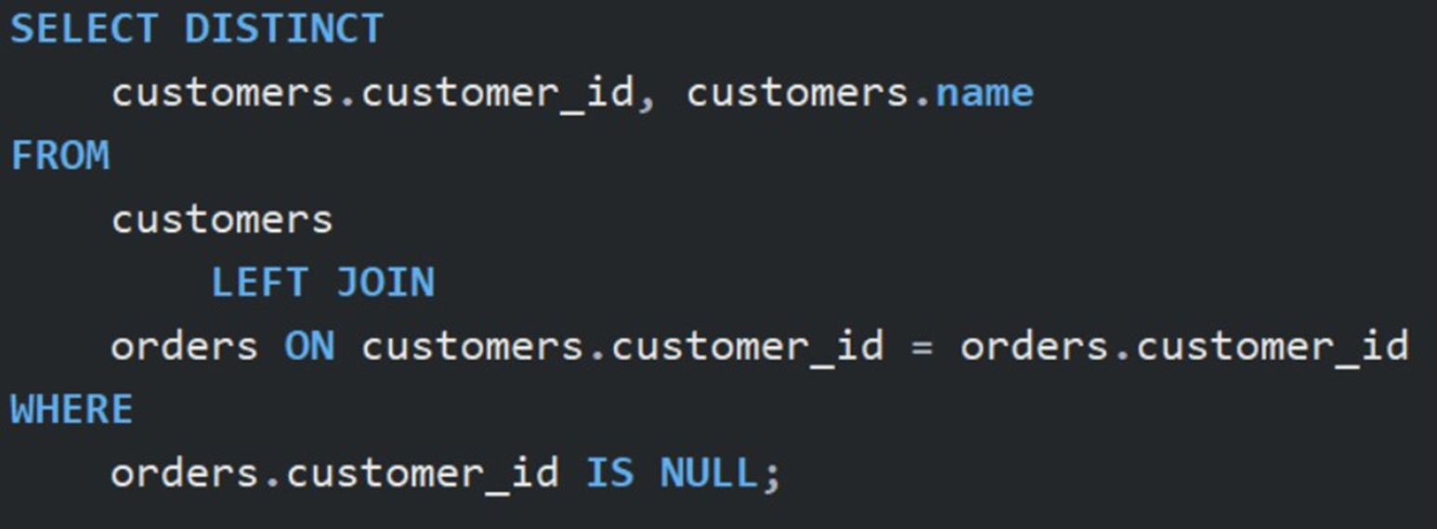
7. Display all customers who have never placed an order.

Slide 11
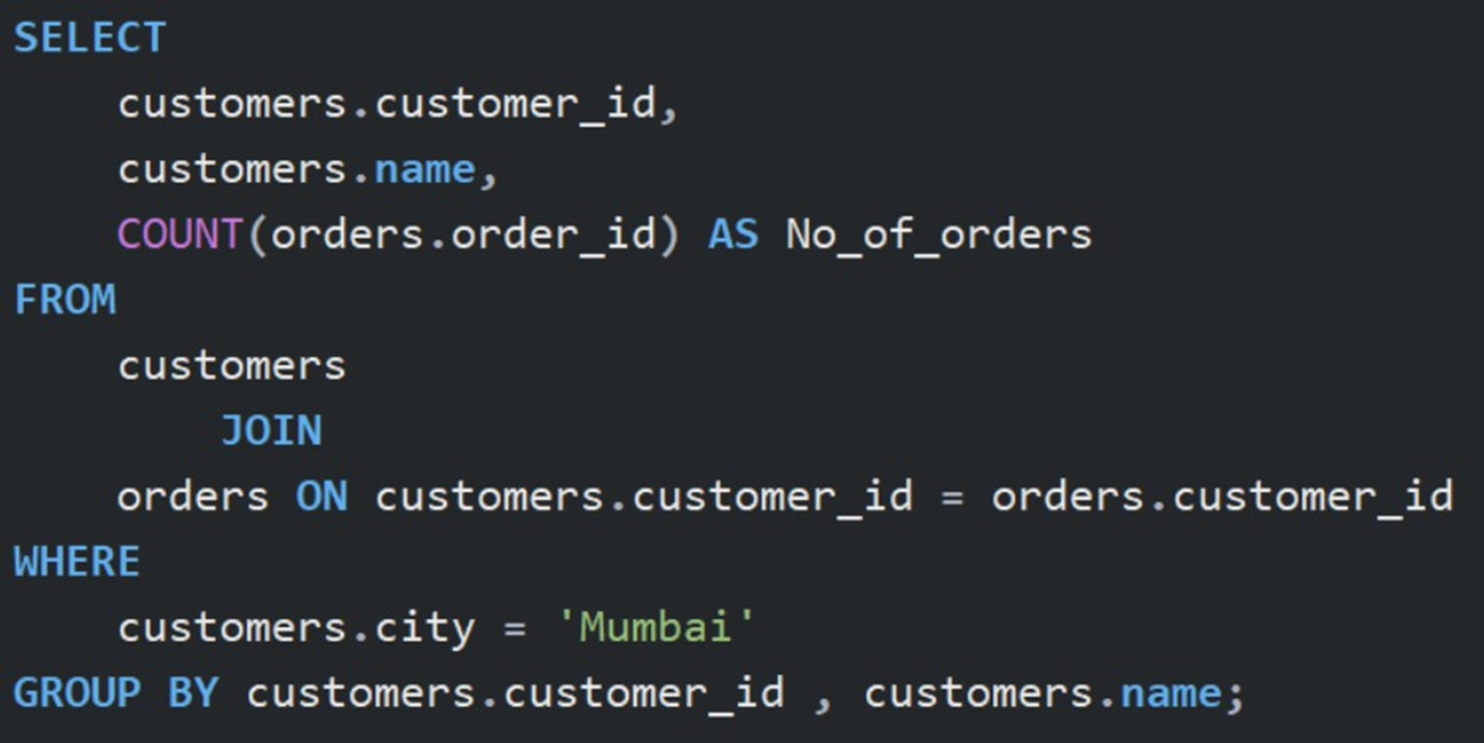
8. Find the number of orders placed by each customer in 'Mumbai'.

Slide 12
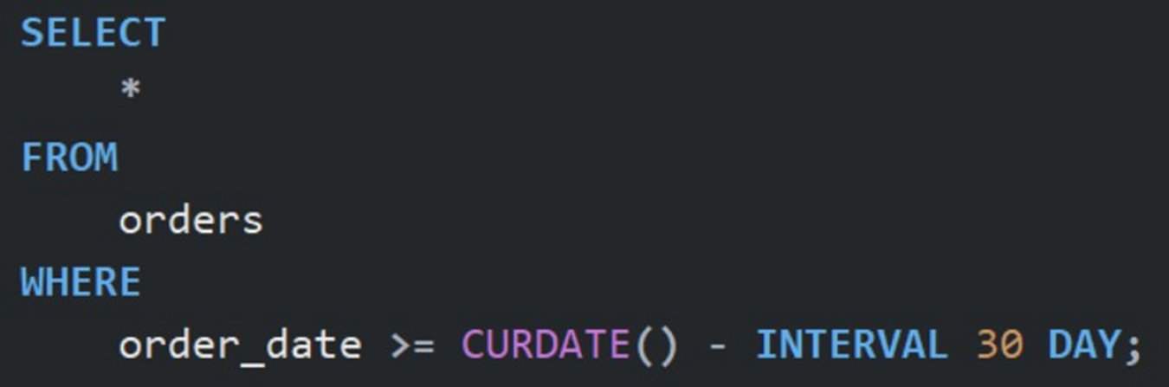
9. Display all orders placed in the last 30 days.

Slide 13
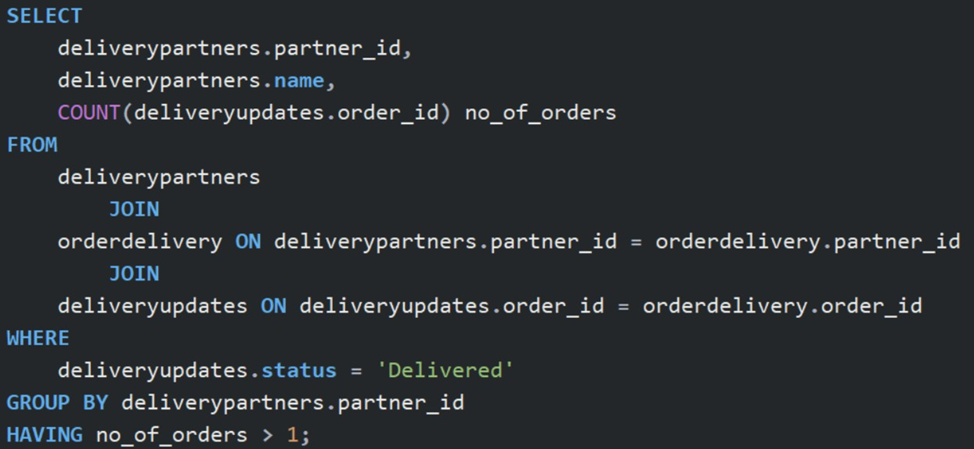
10. List all delivery partners who have completed more than 1 delivery

Slide 14
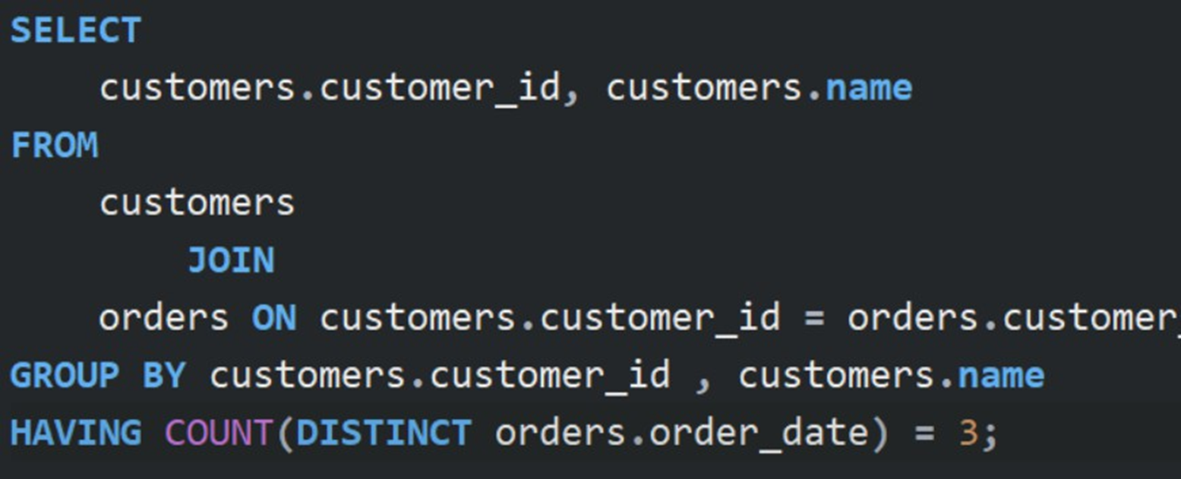
11. Find the customers who have placed orders on exactly three different days.

Slide 15
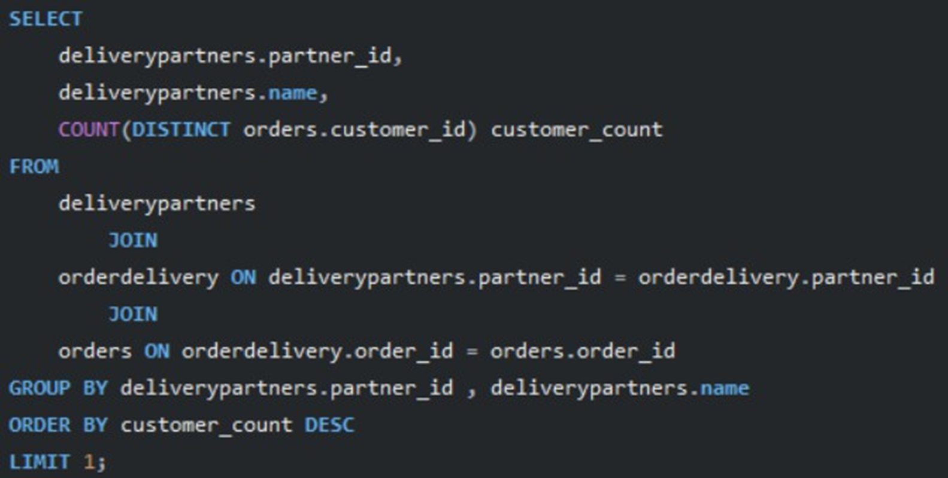
12. Find the delivery partner who has worked with the most different customers.

Slide 16
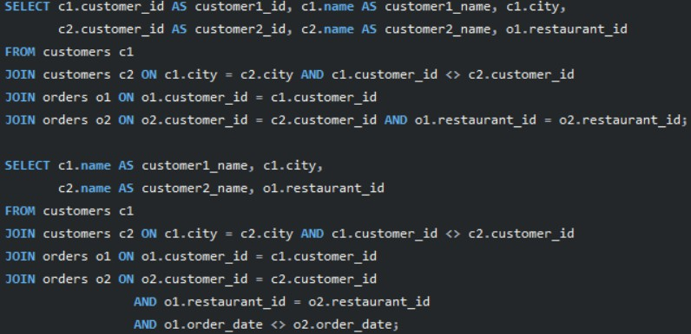
13. Identify customers who have the same city and have placed orders at the same restaurants, but on different dates.

Slide 17
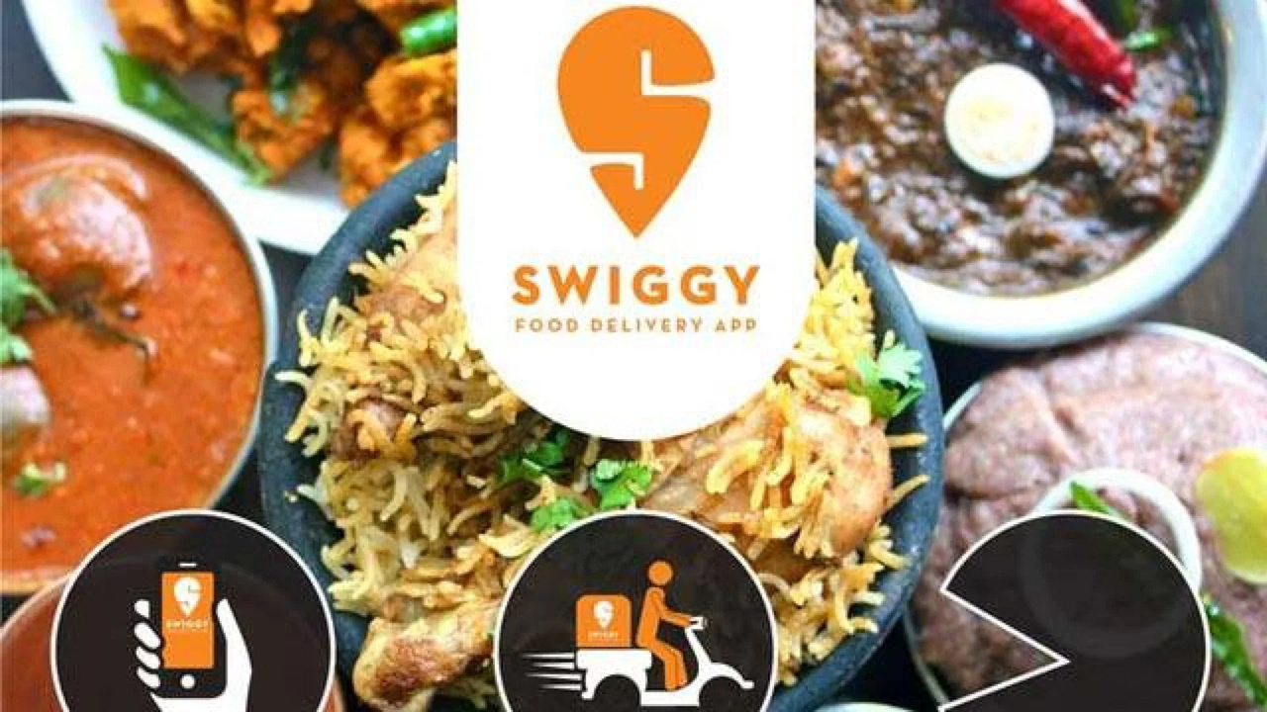
End
Thank you
www.linkedin.com/in/anoop1420

